Slide 1
Decision Tree
Lecture 04

Slide 2
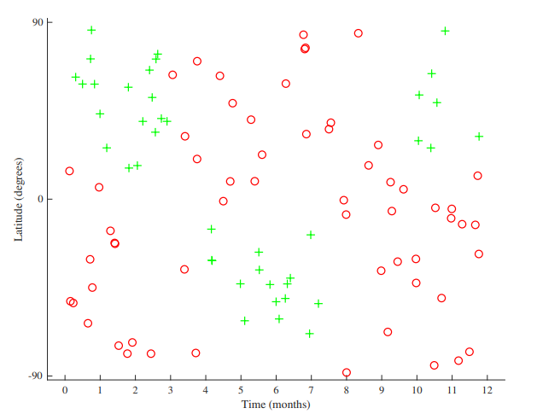
Motivation
DT is a non-linear machine learning technique.

Slide 3
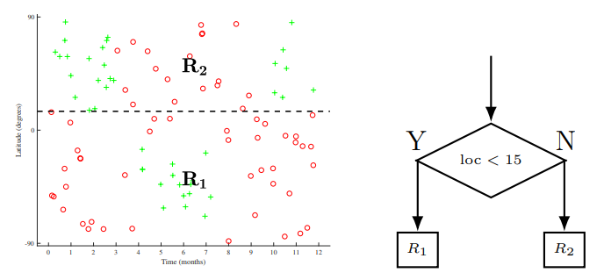
Splitting the input space X by the location feature, with a threshold of 15, creating child regions R1 and R2.

Slide 4
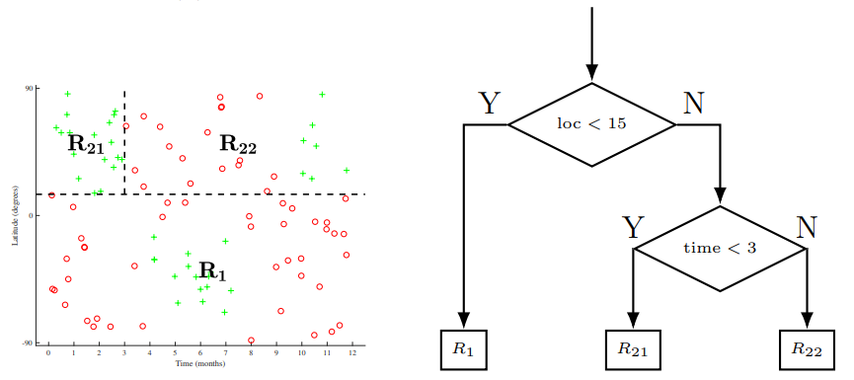
Then recursively select one of these child regions (in this case R2) and select a feature (time) and threshold (3), generating two more child regions (R21 and R22)

Slide 5
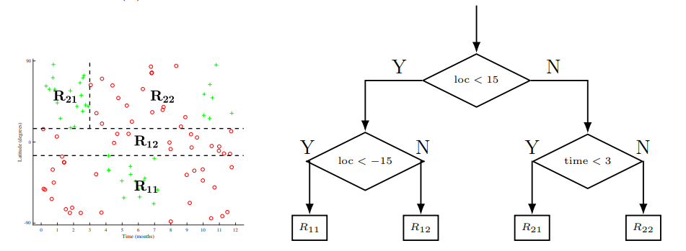
Selecting any one of the remaining leaf nodes (R1, R21, R22).

Slide 6
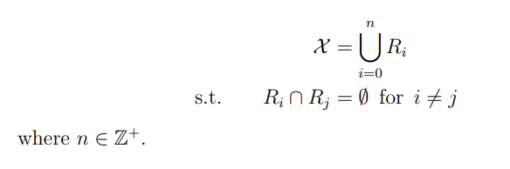

Cont’d
Partitioning the input space X into disjoint subsets (or regions) R_{i} :
Formally, given a parent region R_{p}, a feature index j, and a threshold t ∈ R, we obtain two child regions R₁ and R₂ as follows:

Slide 7
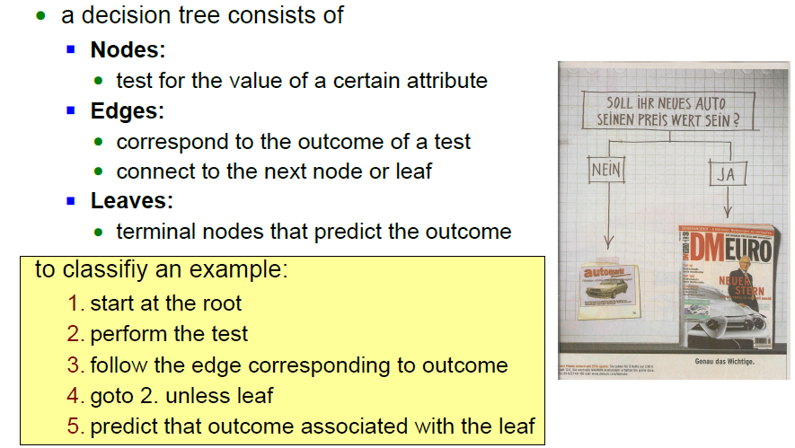
Decision-Tree

Slide 8
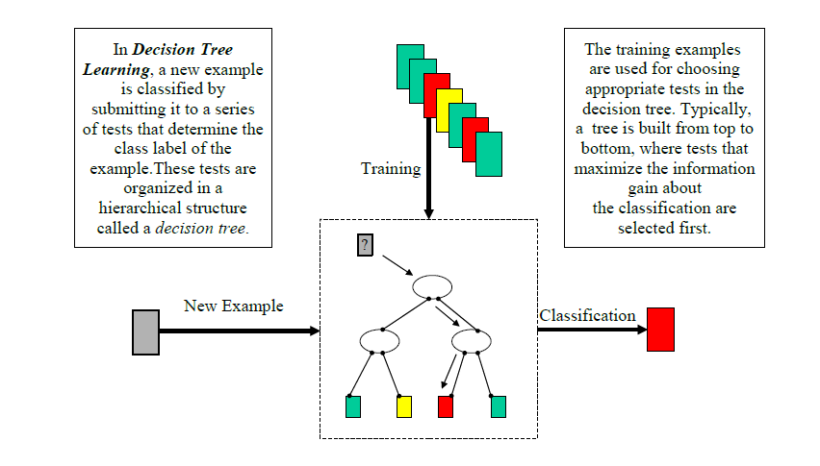
Decision-Tree Learning

Slide 9
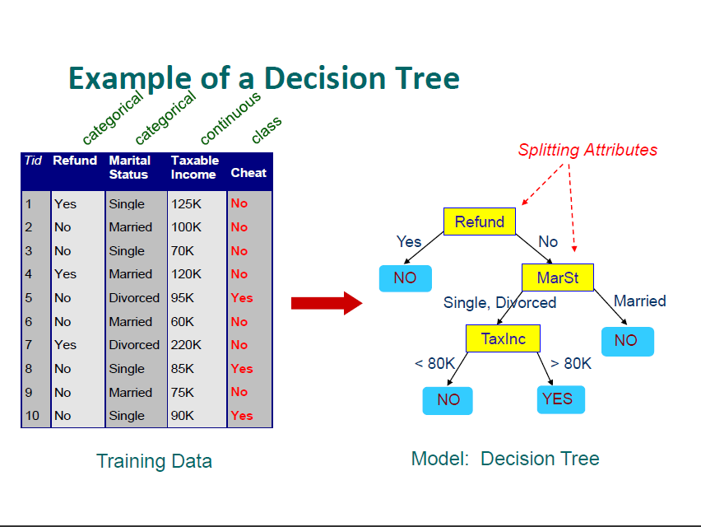

Slide 10
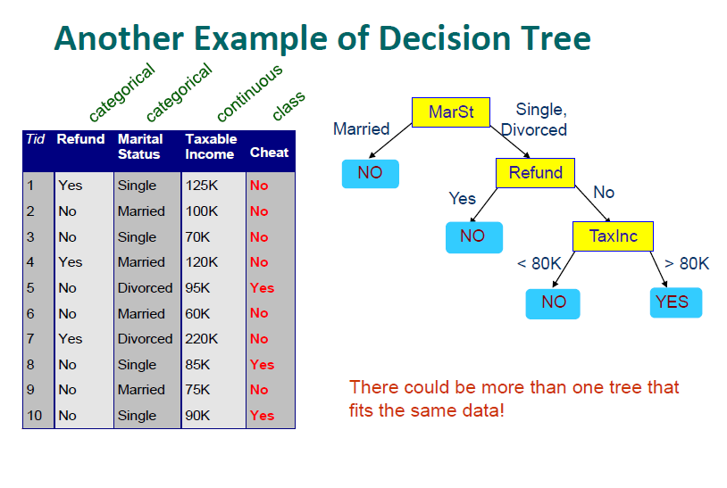

Slide 11
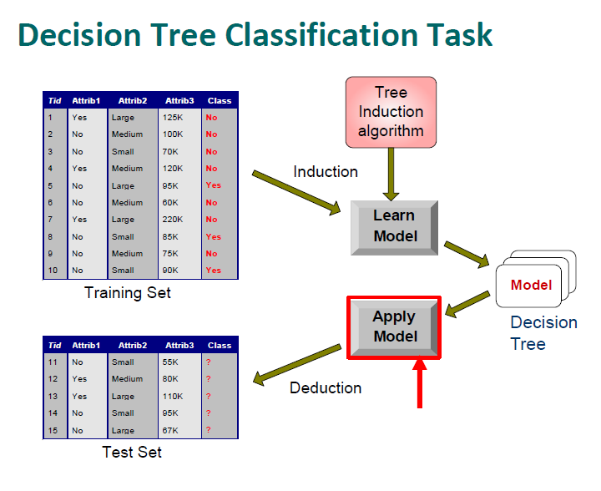

Slide 12
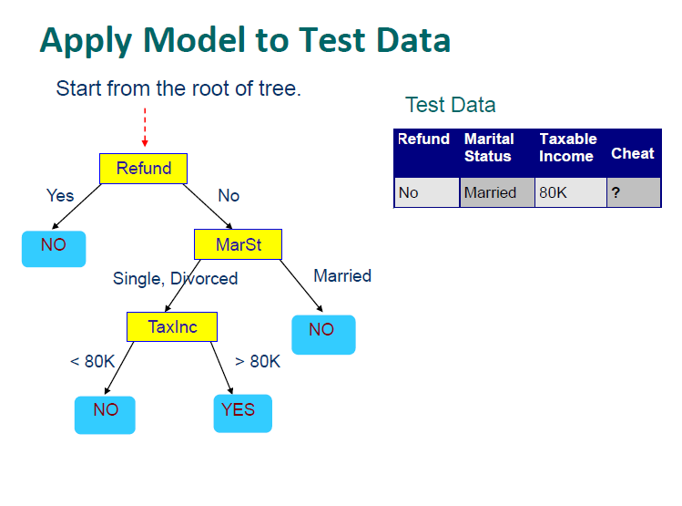

Slide 13
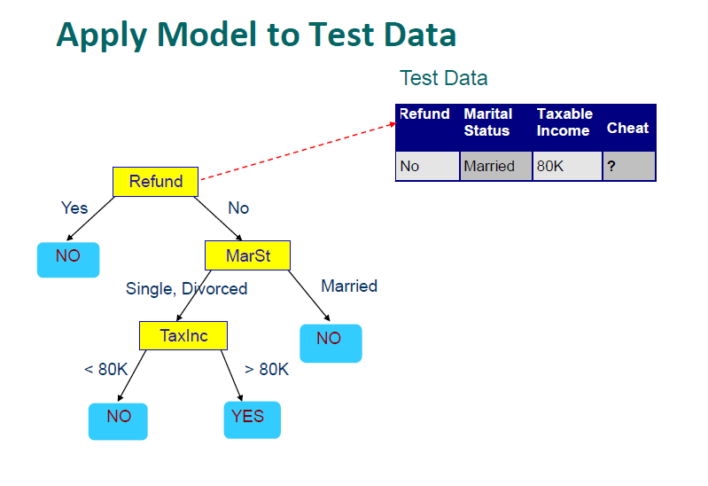

Slide 14
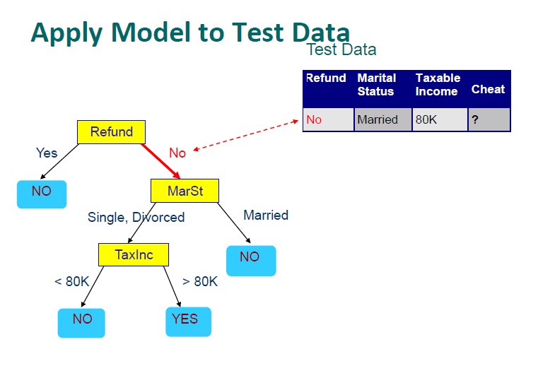

Slide 15
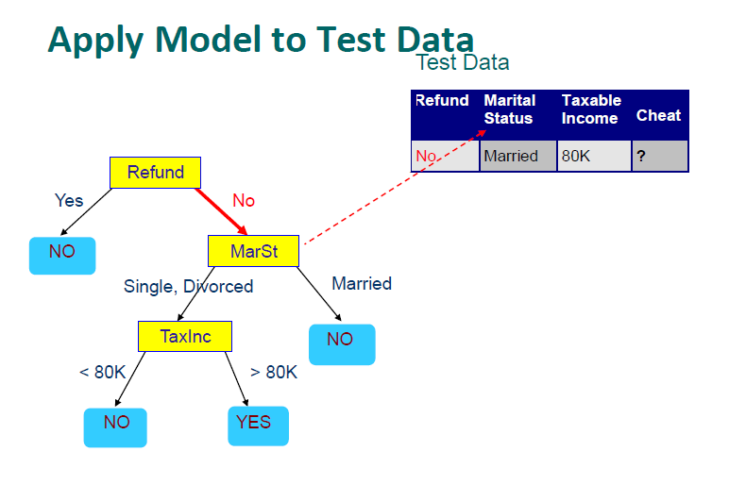

Slide 16
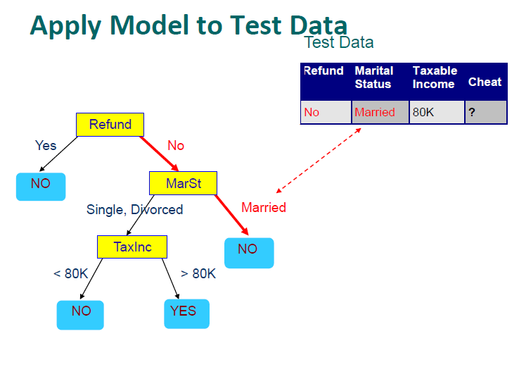

Slide 17
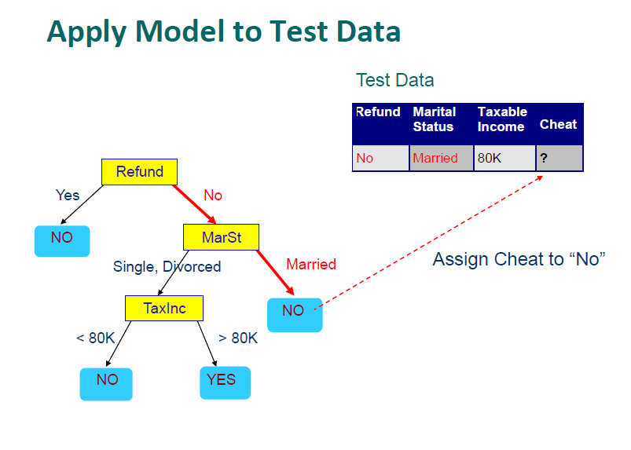

Slide 18
Decision Trees Functions
Data compression
Prediction

Slide 19
DECISION TREE
An internal node is a test on an attribute
A branch represents an outcome of the test, e.g., COLOR = Red
A leaf node represents a class label or class label distribution
At each node, one attribute is chosen to split training examples into distinct classes as much as possible
A new case is classified by following a matching path to a leaf node
The no. of leaf nodes represent the no of branches.
Each branch corresponds to a classification rule.

Slide 20
Decision Tree Based Classification
Advantages:
–Inexpensive to construct
–Extremely fast at classifying unknown records
–Easy to interpret for small-sized trees
–Decision trees provide a clear indication of which features are most important for classification.
–Decision trees perform classification without requiring much computation.
–Accuracy is comparable to other classification techniques for many simple data sets

Slide 21
The TDIDT Algorithm (Top-Down Induction of Decision Trees)
Many Algorithms:
–Hunt’s Algorithm (one of the earliest)
–CART
–ID3 (Iterative Dichotomiser 3), C4.5, C5.0
–SLIQ,SPRINT

Slide 22
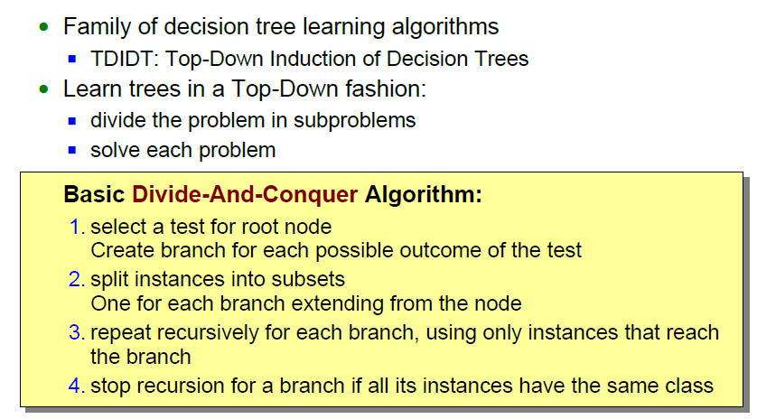
Divide-And-Conquer Algorithms

Slide 23
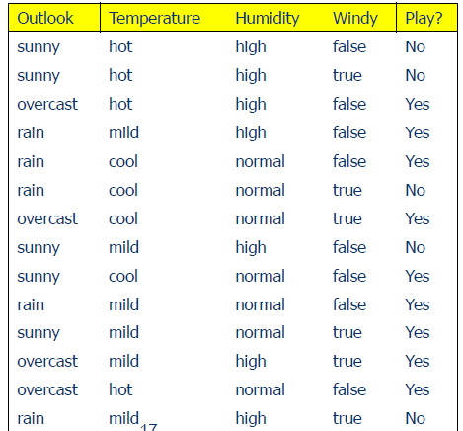
Weather Data: Play or not Play?Outlook

Slide 24
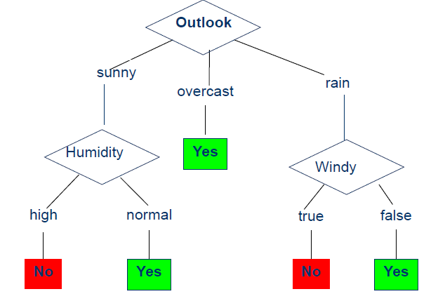
Example Tree for “Play?”

Slide 25
Building Decision Tree
Top-down tree construction
–At start, all training examples are at the root
–Partition the examples recursively by choosing one attribute each time
Bottom-up tree pruning
–Remove subtrees or branches, in a bottom-up manner, to improve the estimated accuracy on new

Slide 26
Choosing the Splitting Attribute
At each node, available attributes are evaluated on the basis of separating the classes of the training examples. A Goodness function is used for this purpose
Typical goodness functions:
–information gain (ID3/C4.5)
–accuracy
–giniindex
–others (information gain ratio)

Slide 27
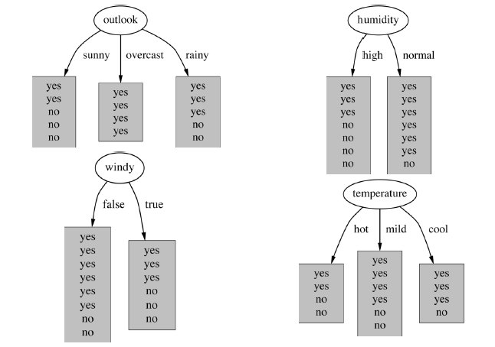
Which attribute to select?

Slide 28
A criterion for attribute selection
Which is the best attribute?
–The one which will result in the smallest tree
–Heuristic: choose the attribute that produces the “purest” nodes
Popular impurity criterion: information gain
–Information gain increases with the average purity of the subsets that an attribute produces
Strategy: choose attribute that results in greatest information gain

Slide 29


Computing information
Entropy measures the (im)purity of an arbitrary collection of examples. Given a collection S, containing positive and negative examples of some target concept, the entropy of S relative to this boolean classification is:
where p+, is the proportion of positive examples in S and p-, is the proportion of negative examples in S.
Then we use Information gain to measure the expected reduction in entropy caused by partitioning the examples according to this attribute using:

Slide 30
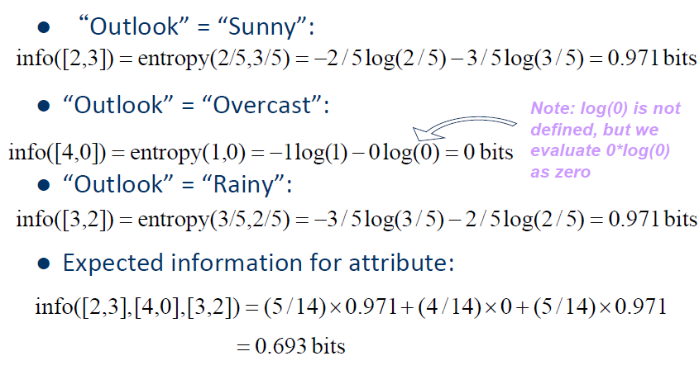
Example: attribute “Outlook”

Slide 31
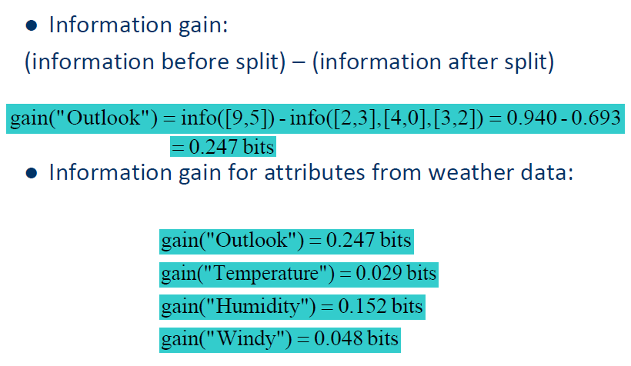
Computing the information gain

Slide 32
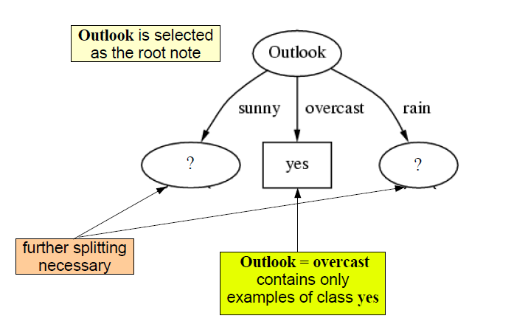
Cont’d

Slide 33
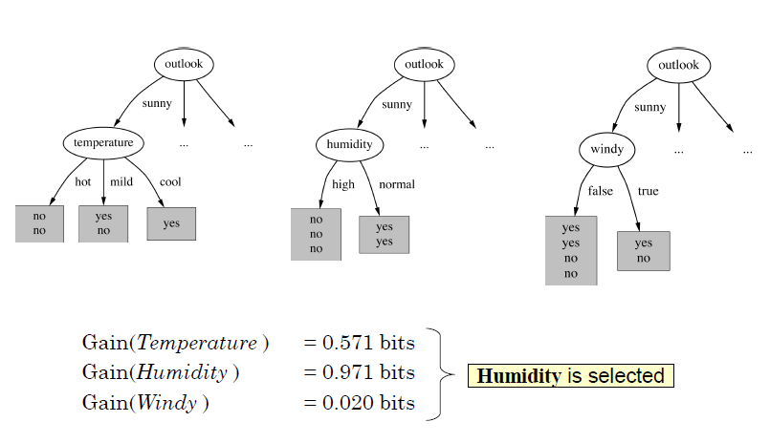
Continuing to split

Slide 34
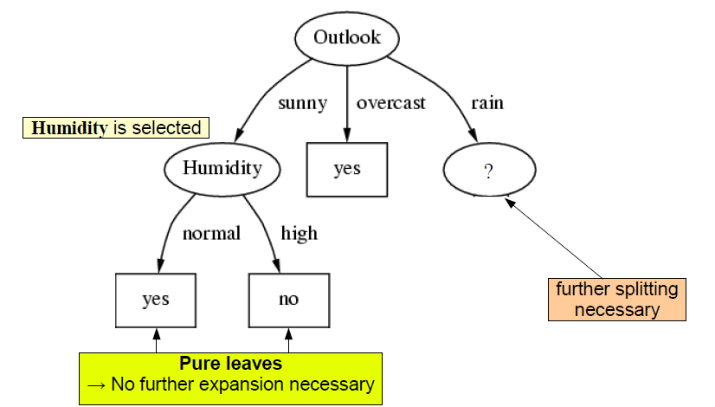
Continuing to split

Slide 35
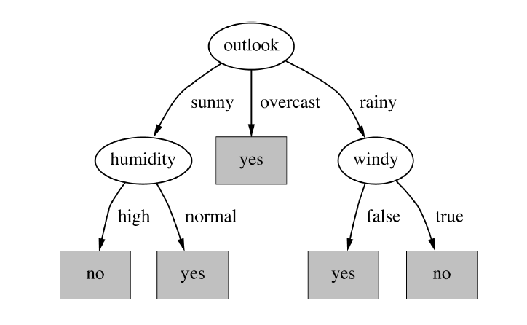
The final decision tree
Note: not all leaves need to be pure; sometimes identical instances have different classes
- Splitting stops when data can’t be split any further

Slide 36
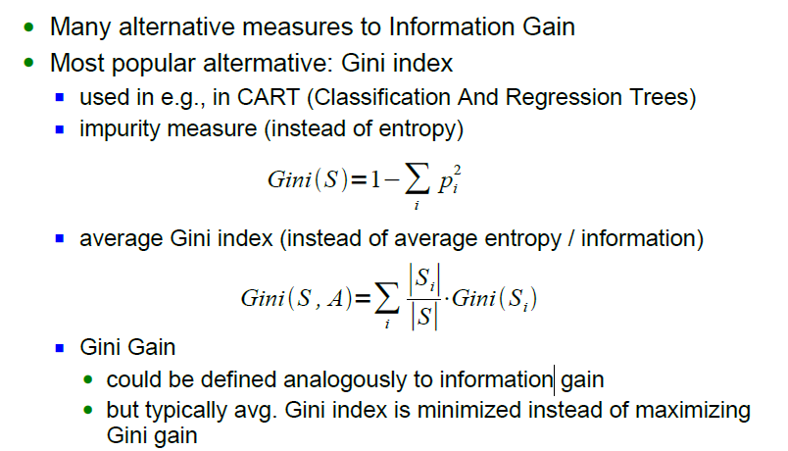
*CART Splitting Criteria: Gini Index

Slide 37
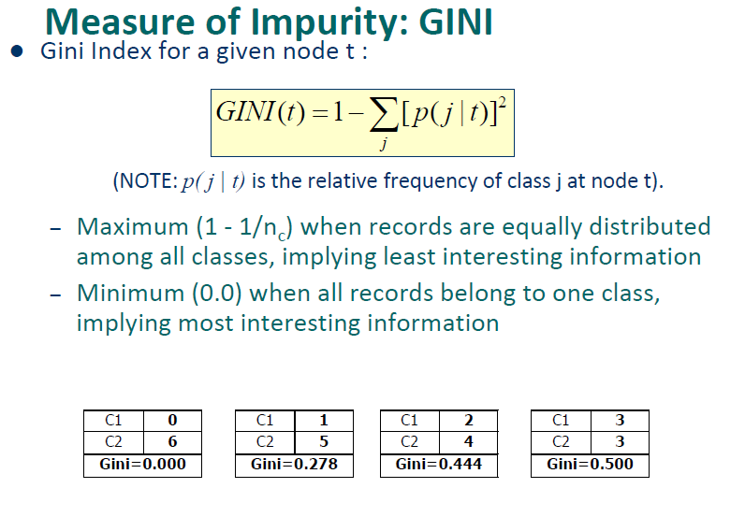

Slide 38
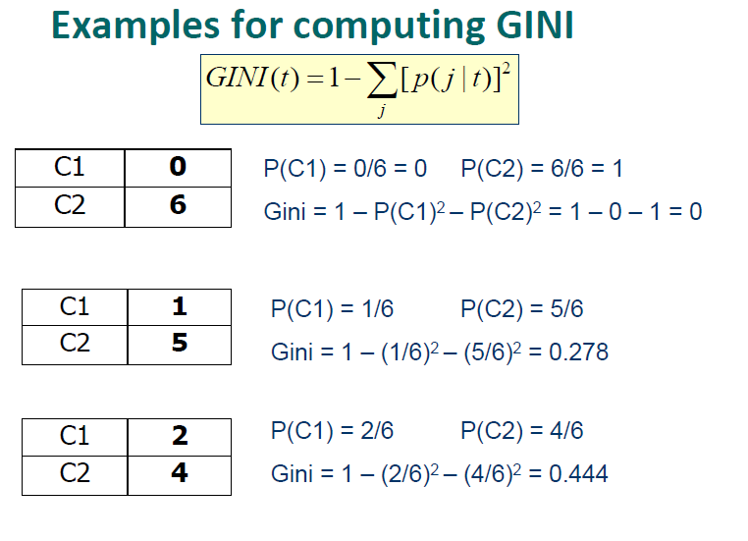

Slide 39
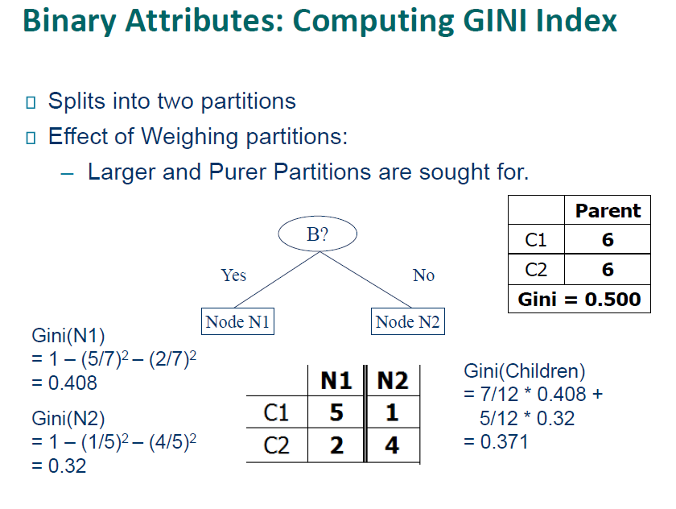

Slide 40
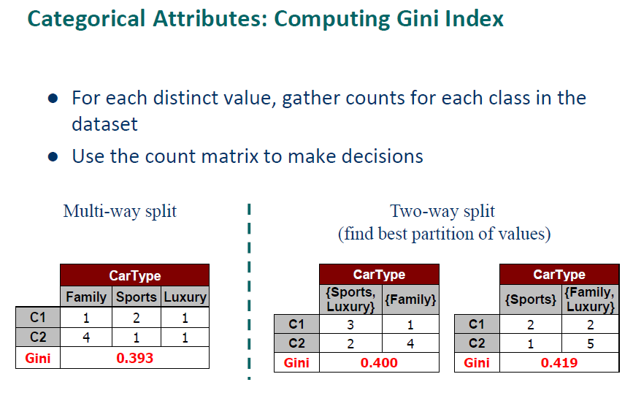

Slide 41
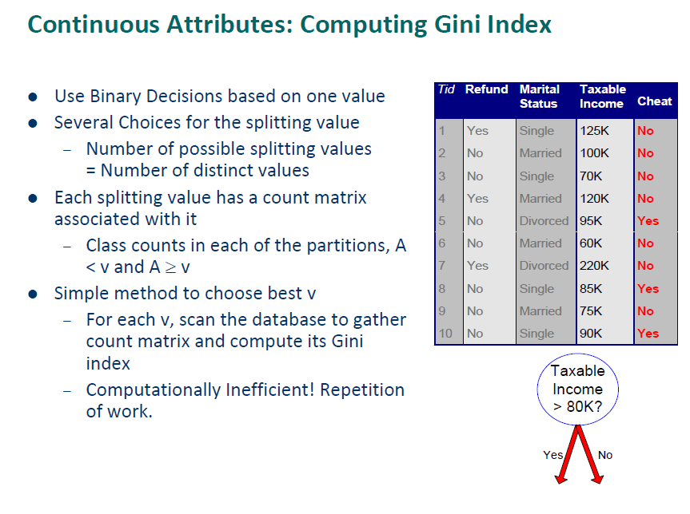

Slide 42
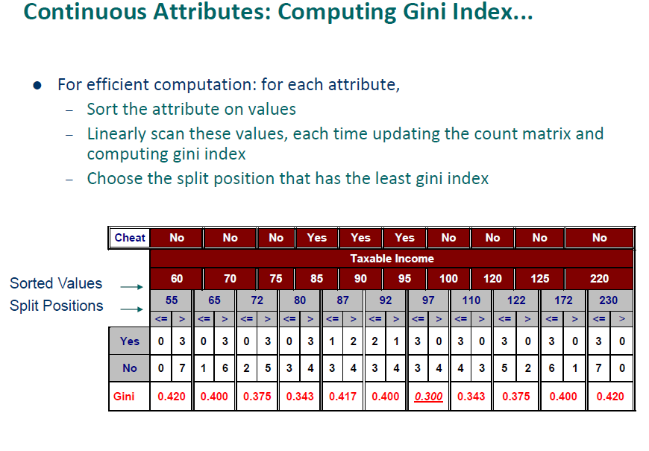

Slide 43
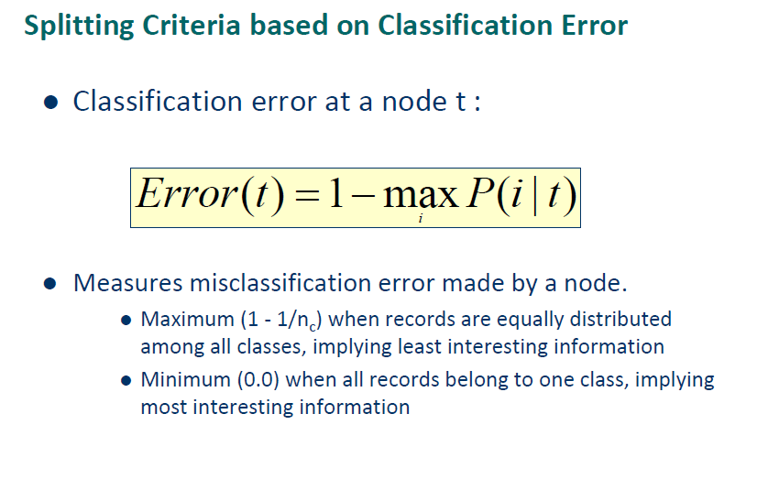

Slide 44
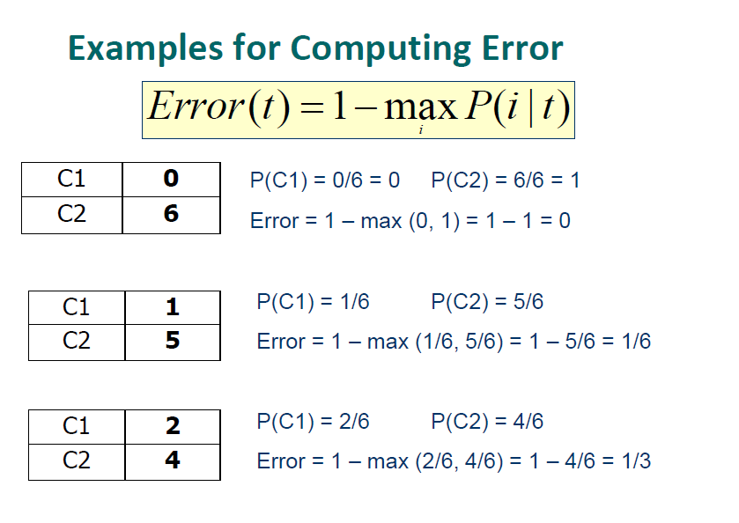

Slide 45
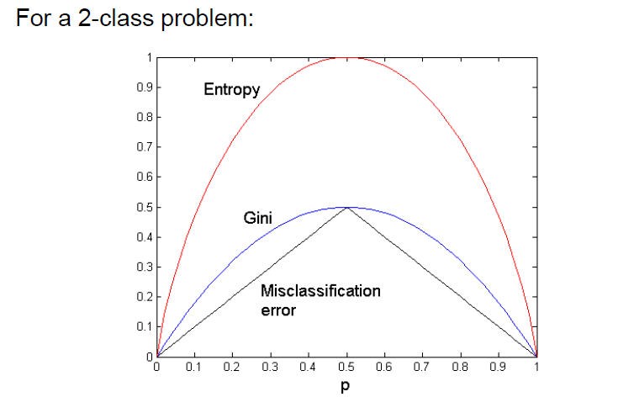
Comparison among Splitting Criteria

Slide 46
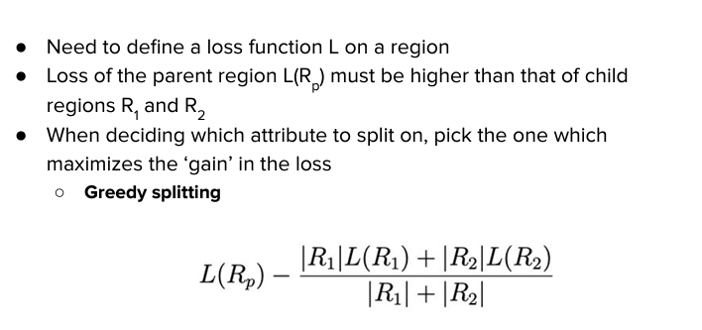
Defining a Loss Function

Slide 47
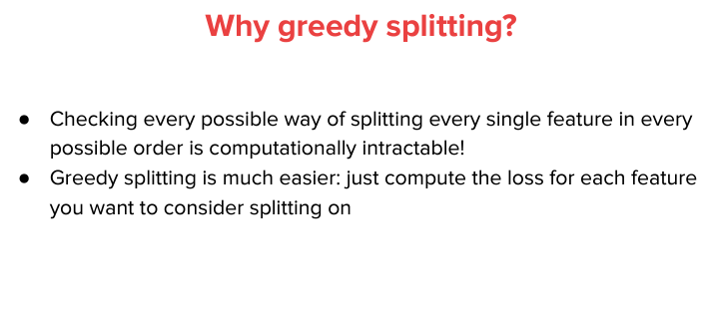

Slide 48
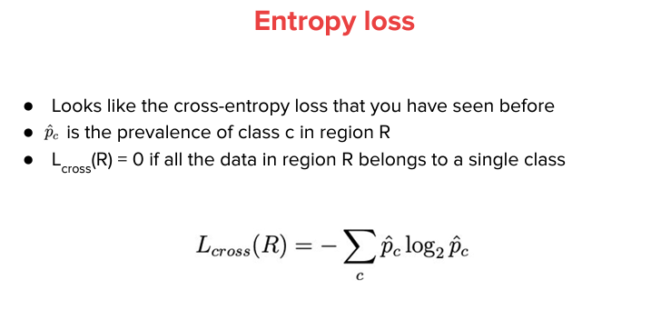

Slide 49
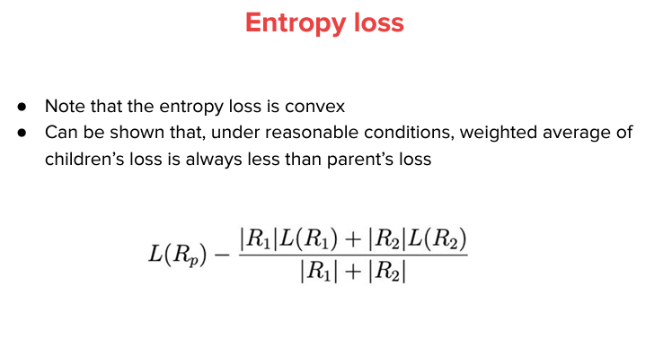

Slide 50
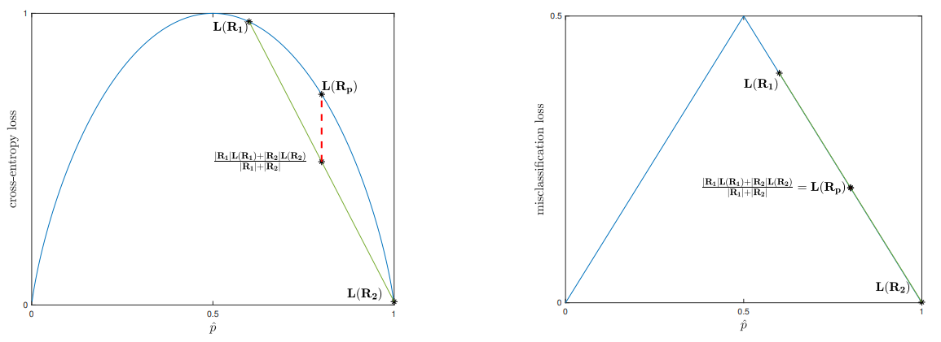
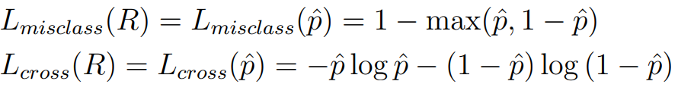
Cross-Entropy Loss Vs. Misclassification Loss

Slide 51
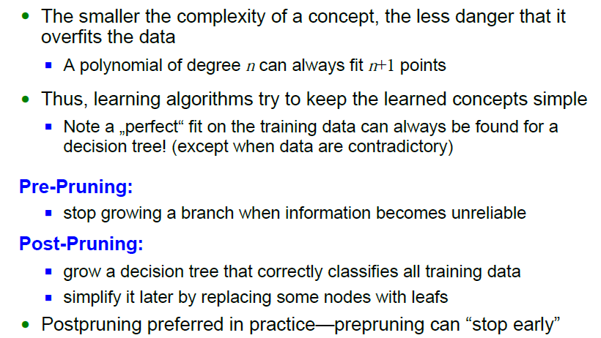
Overfitting and Pruning

Slide 52
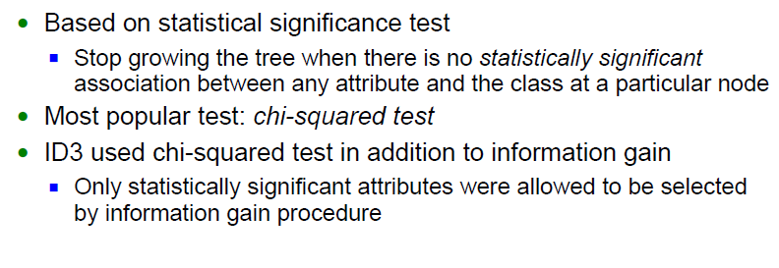
Prepruning

Slide 53
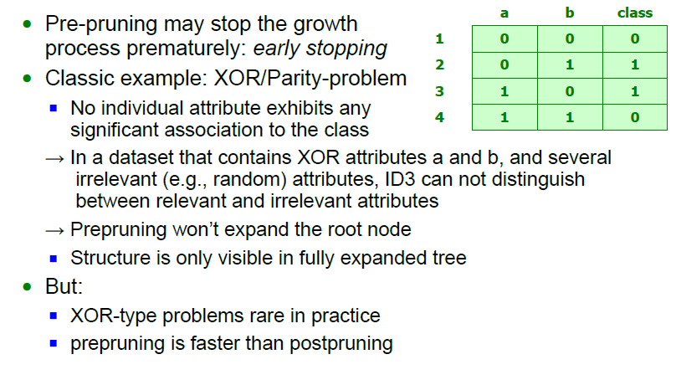
Early stopping

Slide 54
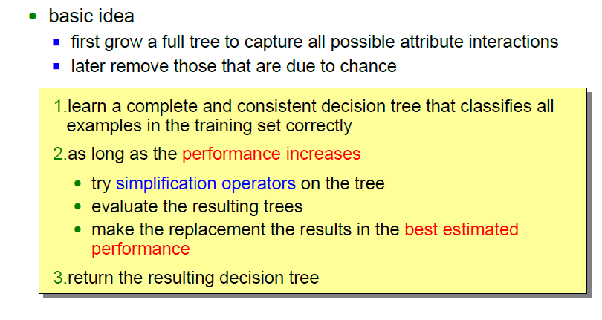
Post-Pruning

Slide 55
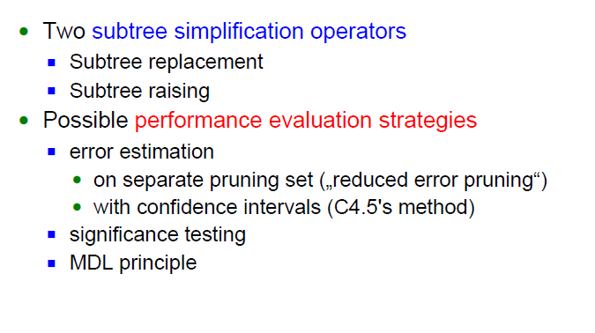
Postpruning
MDL (Minimum Description Length) – Minimize: size(tree) + size(misclassification(tree))
https://artint.info/html/ArtInt_188.html

Slide 56
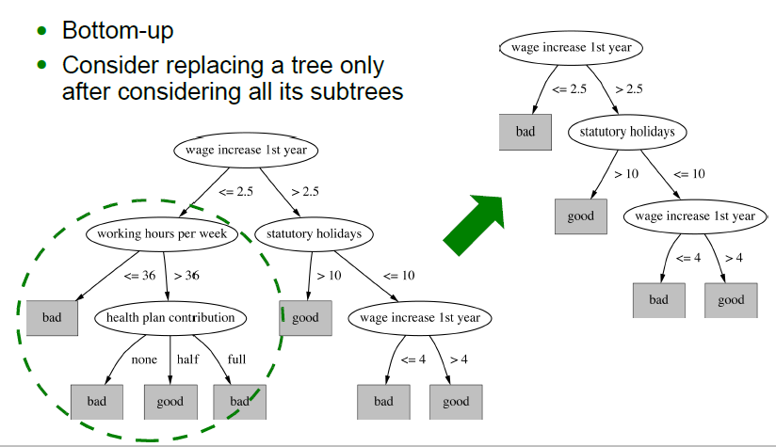
Subtree replacement

Slide 57
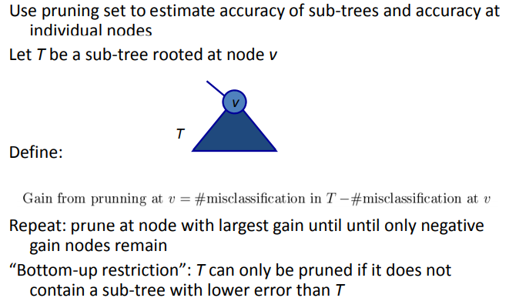
Reduced Error Pruning (REP)

Slide 58
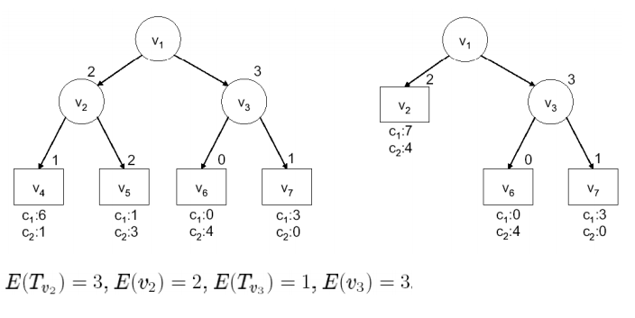
Example

Slide 59

Subtree raising

Slide 60
Subtree replacement Vs. subtree raising
Subtree replacement selects a subtree and replaces it with a single leaf.
Subtree raising selects a subtree and replaces it with the child one (ie, a "sub-subtree" replaces its parent)

Slide 61

Regression Problems

Slide 62

Regression Problems
Regression Tree Example: https://sefiks.com/2018/08/28/a-step-by-step-regression-decision-tree-example/

Slide 63

Model Trees

Slide 64

Source: https://towardsdatascience.com/introduction-to-model-trees-6e396259379a

Slide 65
Stopping Criteria for Tree Induction
Stop expanding a node when all the records belong to the same class
Stop expanding a node when all the records have similar attribute values
Early termination

Slide 66

Some Disadvantages of DT
High variance
Poor additive modeling
as seen below on the left, a simple decision boundary of the form x₁ + x₂ could only be approximately modeled through the use of many splits, as each split can only consider one of x₁ or x₂ at a time. A linear model on the other hand could directly derive this boundary, as shown below right.
Solution: A common (and successful) way to address these issues is through ensembling methods – our next topic

Slide 67

Summary

